Slide 1

Social Network Ads
~ Amir

Slide 2
Outline
Introduction
Literature Review
Data Collection
Exploratory Data Analysis
Network Analysis
Data Preprocessing
System Architecture
Result Evaluation
Conclusion
Reference

Slide 3
Introduction
Social network ads are advertisements that are displayed on social media platforms, such as Facebook, Instagram, Twitter, and LinkedIn.
These ads can be targeted to specific audiences based on factors such as age, gender, location, interests, and behaviors.
Businesses and organizations use social network ads to promote their products or services to potential customers who are active on these platforms.
The objective of this analysis is to predict whether a person will buy a product displayed on a social network ad or not, given their age, gender, and salary, and to compare the accuracy of different classification algorithms.

Slide 4
Literature Review
  "An overview of digital media and advertising: An Overview" Dickey, I. J., & Lewis, W. F.: This paper [1] provides a comprehensive overview of social media advertising and its various forms, including display ads, sponsored posts, and influencer marketing.
  "Targeting Consumers on Social Media: An Analysis of Facebook Advertising" by Ferreira, F., & Barbosa, B: This paper [2] analyzes the targeting capabilities of Facebook advertising and the ways in which they can be used to reach specific audiences.

Slide 5
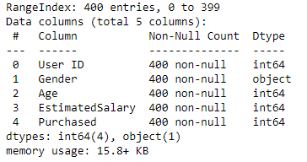
Data Collection
The data is about social network Ads taken from Network Repository [3].
The dataset includes customer id, gender, age, salary, and whether he/she purchased anything or not.
Data Info

Slide 6
Exploratory Data Analysis
How is gender distributed?
How is age distributed?
How is age distributed per gender?
Is there any correlation between salary and age?
Statistics for purchase feature

Slide 7
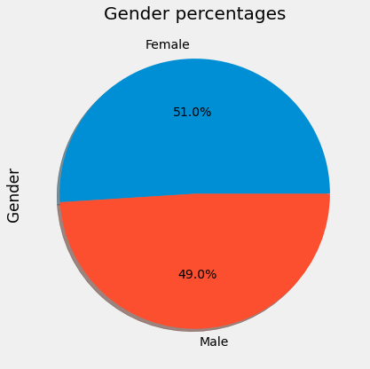
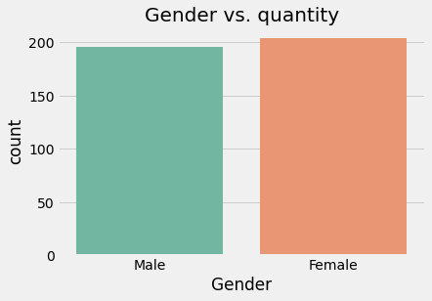
Gender Distribution
It seems that both gender are equally distributed

Slide 8
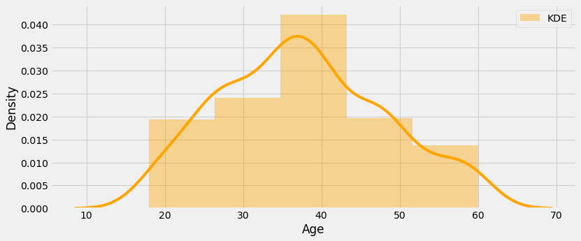
Age Distribution
Age is normally distributed around 37 years, and most of the people studied are from 35 to 45 years.

Slide 9
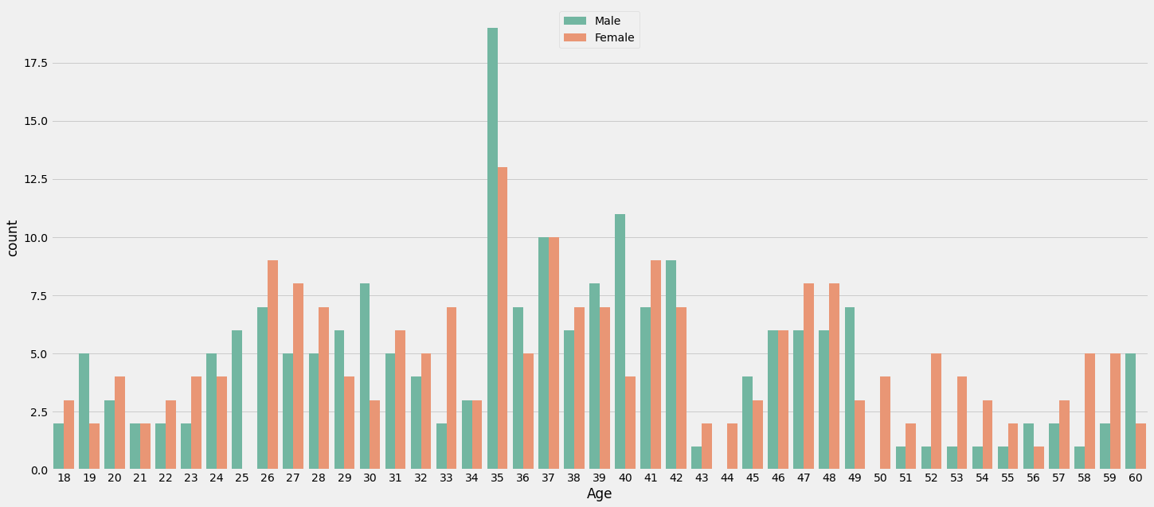
Age Distributed Per Gender
There seems to be equal analyzed people per gender per age, seeing only more men of 35 years.

Slide 10
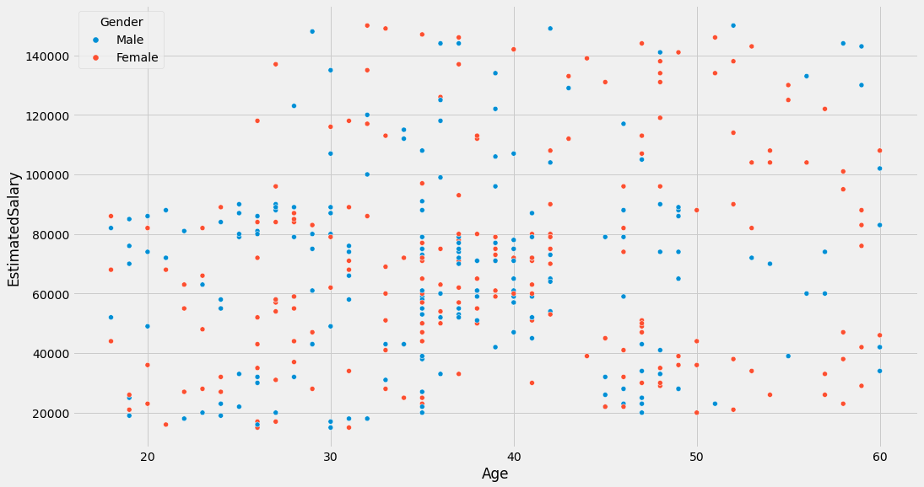
Is there any correlation between salary and age?
There is no correlation between the estimated salary of a male or female with their age

Slide 11
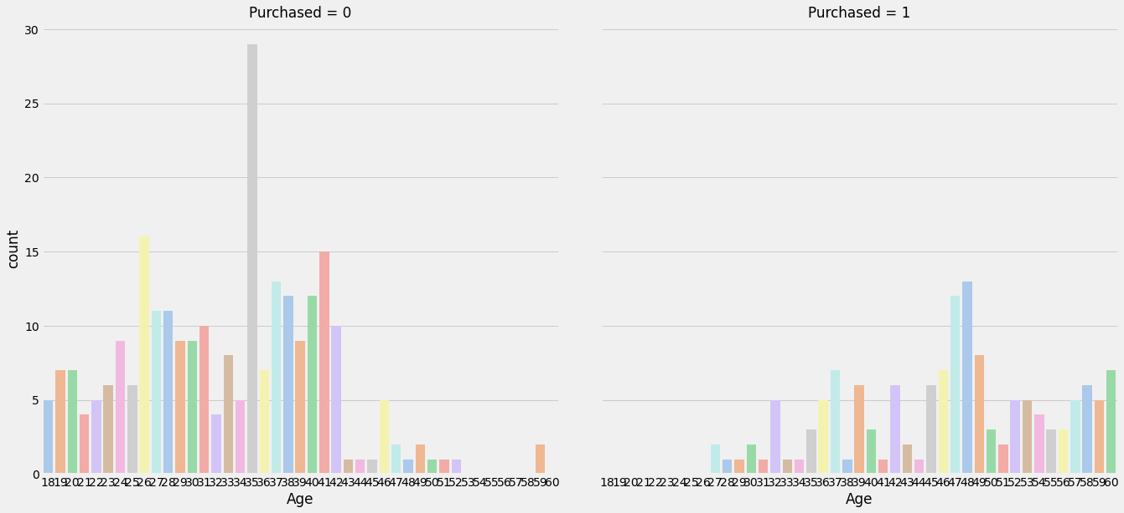
Statistics for the purchased column
The product seems to be intended for people within the range of 50 - 60 years

Slide 12
Network Analysis
How many nodes and edges
Degree Centrality
Closeness Centrality
Eigenvector Centrality

Slide 13
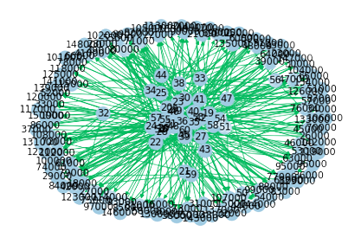
Information of Nodes and edges
Digraph with 160 nodes and 365 edges

Slide 14
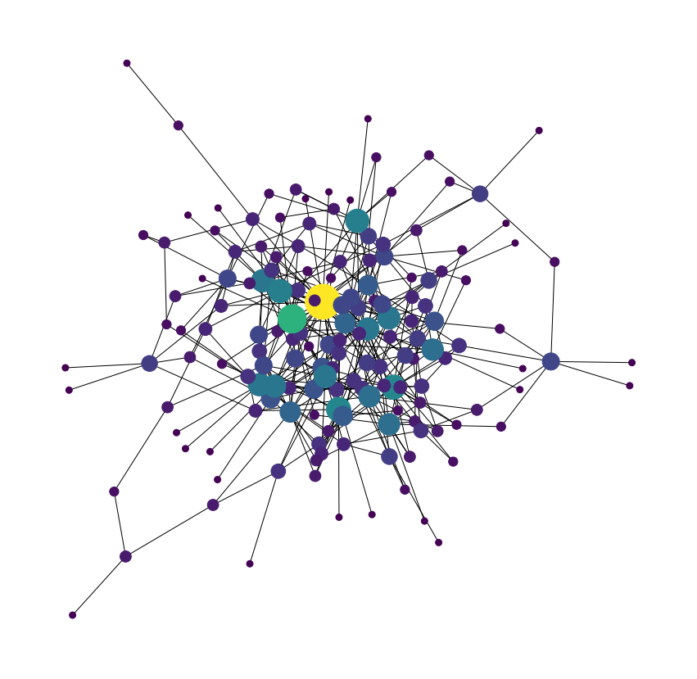
Degree Centrality
Degree centrality measures the importance of a node in a network.
It is calculated as the number of connections (edges) that a node has to other nodes in the network.
Nodes with a high degree of centrality are considered to be more central or essential in the network, as they have many connections to other nodes.
It is one of the most common measures of centrality used in network analysis.
[35, 37, 26, 47, 48]

Slide 15
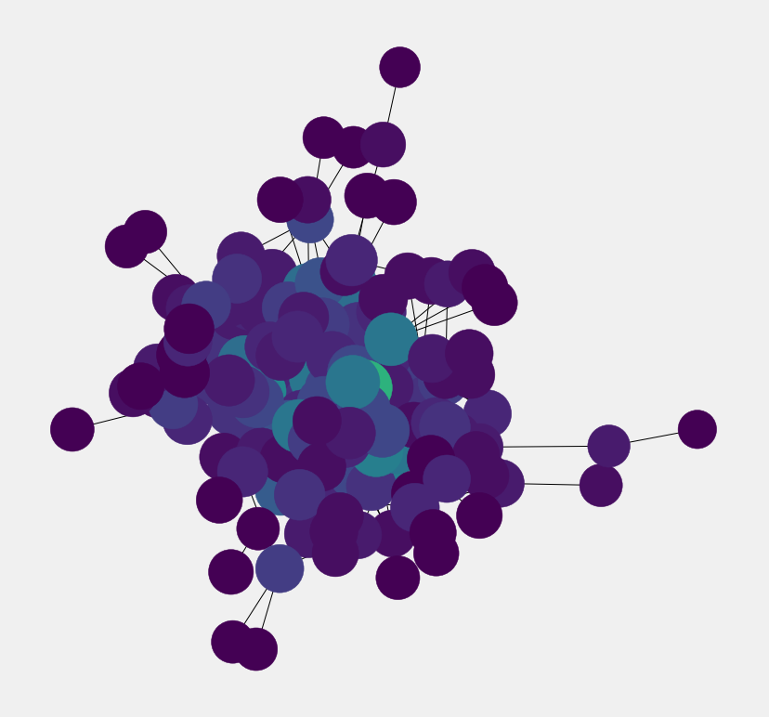
Closeness Centrality
Closeness centrality is a measure of the centrality of a node in a network, which is calculated as the reciprocal of the sum of the shortest paths between the node and all other nodes in the network.
The idea behind this measure is that a node that is central in a network is one that is close to all other nodes in the network.
Nodes with a high closeness centrality have short distances to all other nodes in the network, and therefore have high centrality.
Closeness centrality is a useful measure for identifying "broker" nodes in a network, which have the shortest path to many other nodes.
[35, 79000, 37, 72000, 46]

Slide 16
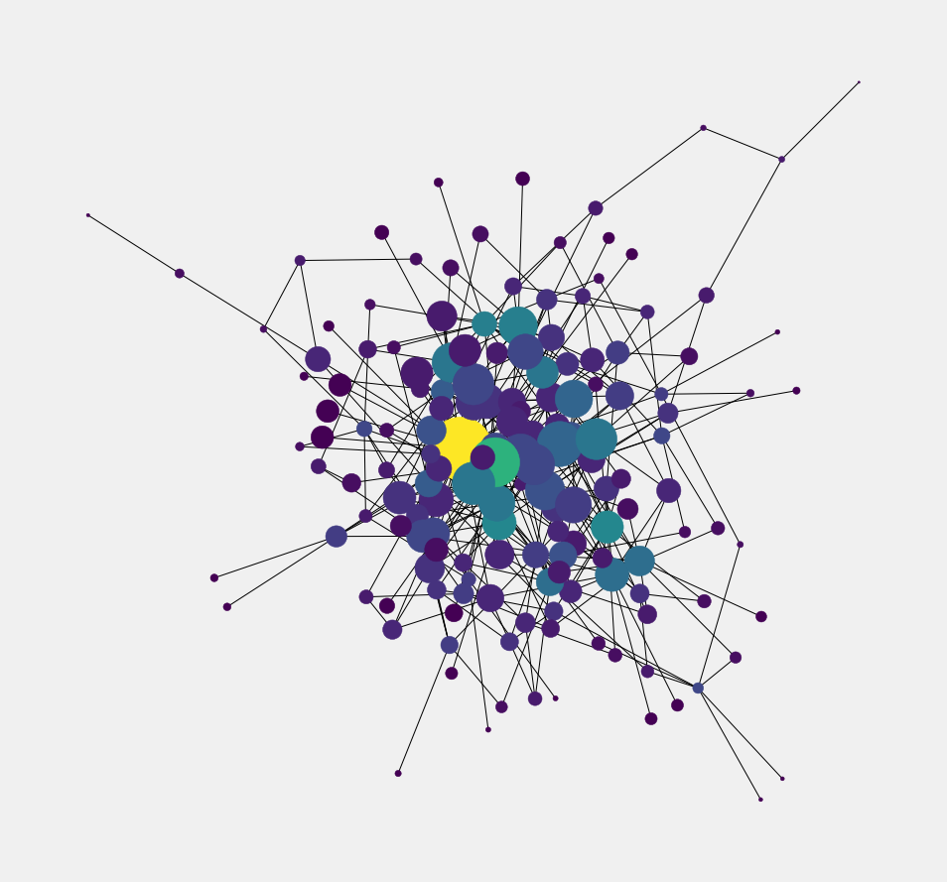
Eigenvector Centrality
Eigenvector centrality is a measure of the importance of a node in a network, similar to degree centrality.
However, unlike degree centrality which only considers the number of connections a node has, eigenvector centrality takes into account the "importance" of the nodes that a node is connected to.
It assigns relative scores to all nodes in the network based on the principle that connections to high-scoring nodes contribute more to the score of the node in question than equal connections to low-scoring nodes.
(-0.9081803316123722,
1.1127791051392522,
-0.9667752643405068,
1.1868881472902744)

Slide 17
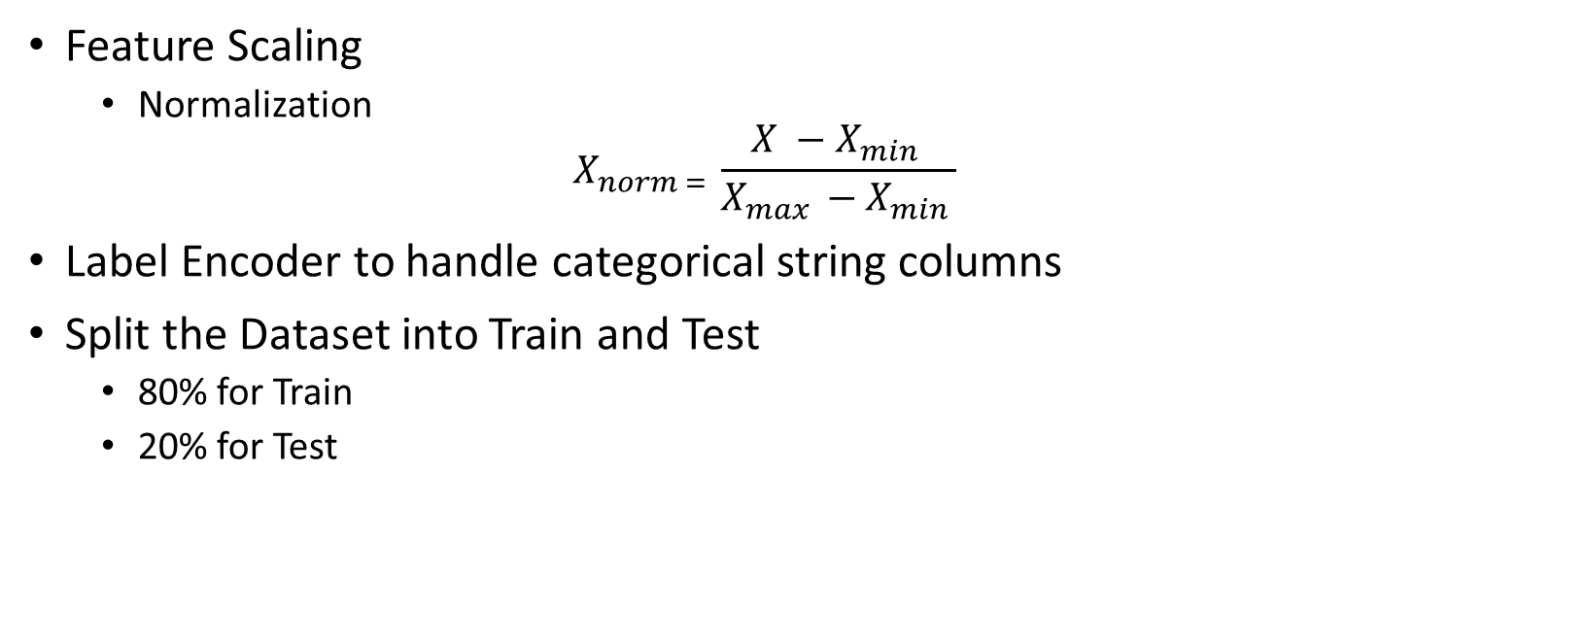
Data Preprocessing
Feature Scaling
  Normalization
  $$X_{norm = }\frac{X −X_{min }}{X_{max }−X_{min }}$$
Label Encoder to handle categorical string columns
Split the Dataset into Train and Test
  80% for Train
  20% for Test

Slide 18
System Architecture
Naïve Bayes
Decision Tree
K-Nearest Neighbors

Slide 19
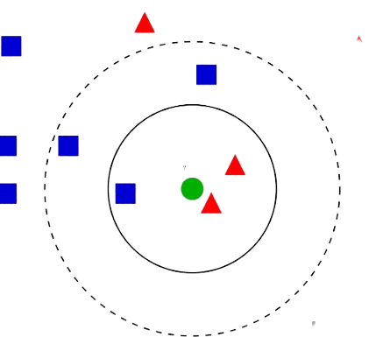
K-Nearest Neighbors
The algorithm finds the k-number of closest data points in the training set to a given test point, and uses the majority class or average value of those points to make a prediction.
The distance metric used to determine the "closeness" of data points can vary, such as Euclidean distance or Manhattan distance.

Slide 20
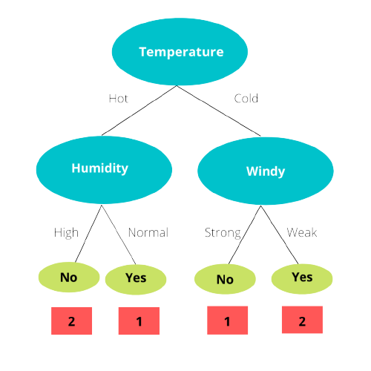
Decision Tree
The algorithm creates a tree-like model of decisions and their possible consequences.
Each internal node in the tree represents a "test" on an attribute, each branch represents the outcome of the test, and each leaf node represents a class label.

Slide 21
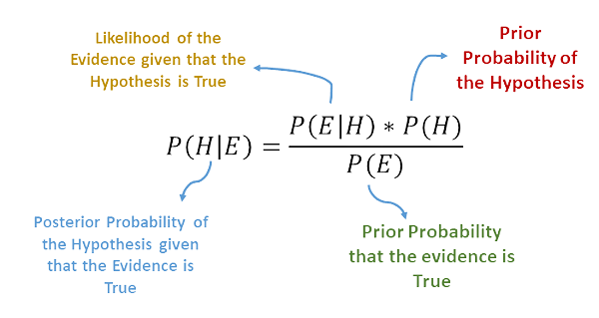
Naïve Bayes
It is based on Bayes' theorem, which describes the probability of an event occurring given the probability of certain related events.
The "naive" part of the name comes from the assumption that the input features are independent of each other, given the output class.

Slide 22
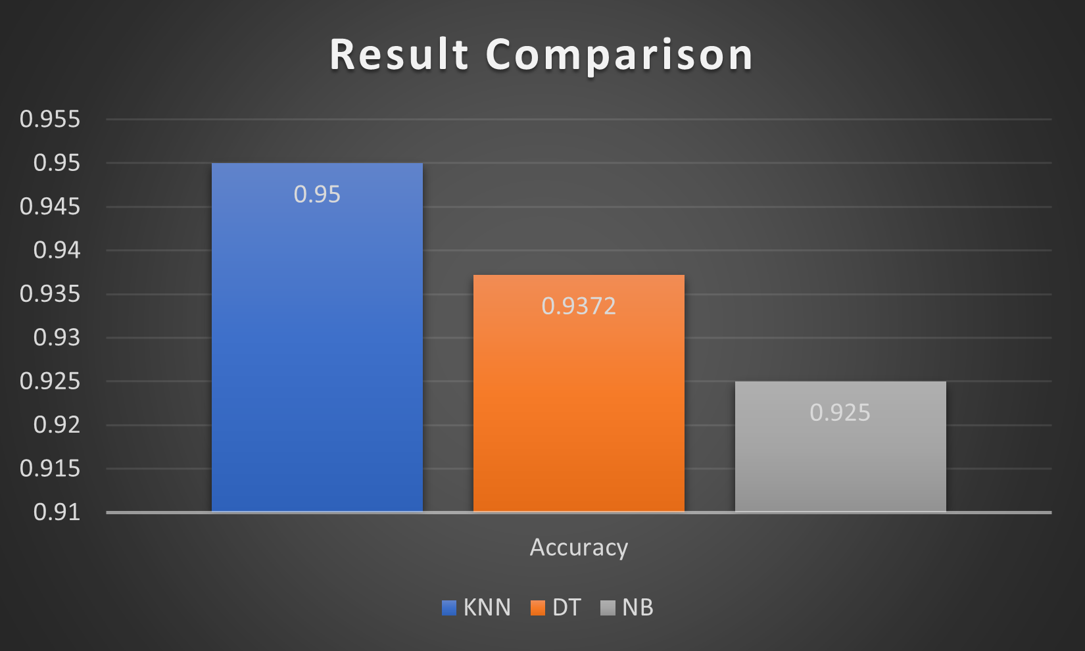
Result Evaluation

Slide 23
Conclusion
In conclusion, the analysis aimed to predict whether a person will buy a product displayed on a social network ad or not, based on their age, gender, and salary. The accuracy of different classification algorithms, including KNN, Decision Tree, and Naive Bayes, were compared in order to determine the most effective method for this prediction. The results of this analysis show that KNN produced the best results, and is the most effective algorithm for this prediction. The findings of this analysis can be used to improve the targeting and effectiveness of social network advertising in the future by implementing the KNN algorithm.

Slide 24
Reference
  [1] Dickey, I. J., & Lewis, W. F. (2012). An overview of digital media and advertising. E-marketing: Concepts, methodologies, tools, and applications, 31-61.
  [2] Ferreira, F., & Barbosa, B. (2017). Consumers' attitude toward Facebook advertising. International Journal of Electronic Marketing and Retailing, 8(1), 45-57.
  [3] https://networkrepository.com/policy.php

Slide 25
Thank You For You Attention
Any Question?
Notes:
I hope I will cross 100

